Slide 1
PROJECT TITLE SECURE DATA HIDING IN IMAGES USING STEGANOGRAPHY
CAPSTONE PROJECT
Presented By: Runasree Shil
Student Name : Runasree Shil
College Name & Department : Techno College Of Engineering
&
B.tech - AIDS

Slide 2
OUTLINE
Problem Statement
Technology used
Wow factor
End users
Result
Conclusion
Git-hub Link
Future scope

Slide 3
Problem Statement
Secure message transmission is crucial in modern communication.
Traditional encryption methods may attract unwanted attention.
This project uses image-based steganography to hide messages in images.
It ensures secrecy by embedding data in pixel values without noticeable distortion.

Slide 4
Technology used
Programming Language: Python
Libraries Used:-
OpenCV (cv2) – for image processing. To install OpenCV go through this command (pip install opencv-python).
NumPy – for array manipulations. To install NumPy go through this command (pip install numpy).
OS – for file handling. To Install OS, go through this command ( pip install os OR pip install os-sys).

Slide 5
Wow factors
Uses LSB (Least Significant Bit) method for data hiding in images.
Custom passcode-based authentication for extra security.
Automatic detection and extraction of hidden messages.
Generates an encrypted image file dynamically.

Slide 6
End users
Cybersecurity Experts: For secure data transmission.
Journalists & Activists: To communicate without detection.
Government & Military: For covert operations.
General Users: Anyone looking for private messaging.

Slide 7
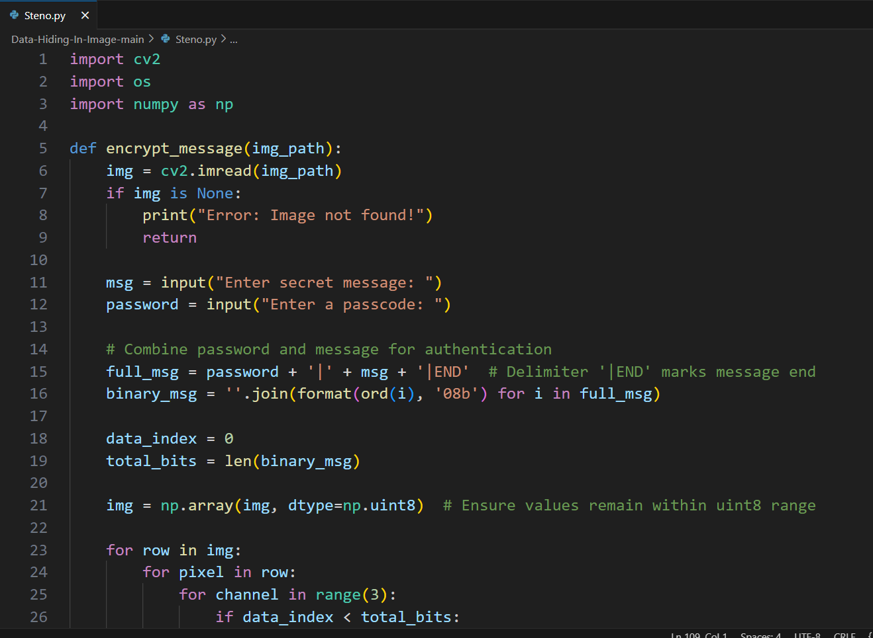


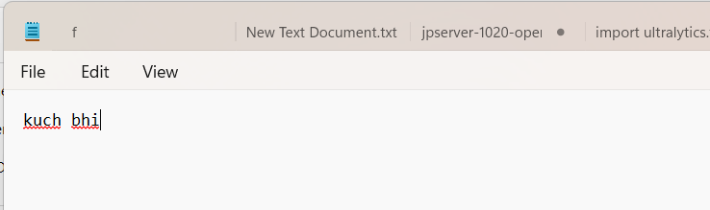
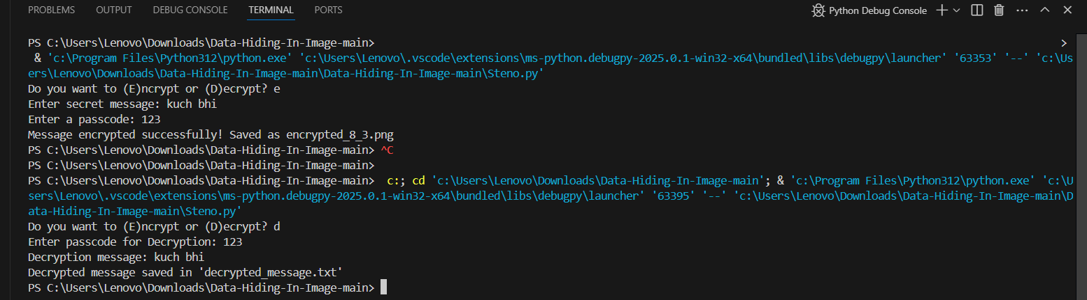
Results
Without embedding Image
Image after embedding message
Encrypted & Decrypted Code
Encrypted data under the Image
Out put of the code

Slide 8
Conclusion
Successfully implemented image steganography for secure communication.
Ensures message privacy while being undetectable to the human eye.
Simple and effective passcode protection for added security.

Slide 9
GitHub Link
GitHub link is :-
Click Here :-
https://github.com/Shil-joysree/Data_Hiding_in_image.git

Slide 10
Future scope(optional)
AI-Powered Encryption – Use deep learning to enhance message hiding.
Blockchain Integration – Store encrypted image hashes for authenticity.
Video Steganography – Hide messages across video frames.
Multi-Level Security – Double encryption for extra protection.
Mobile App Development – Android & iOS steganography tools.

Slide 11
THANK YOU

